Slide 1


Slide 2
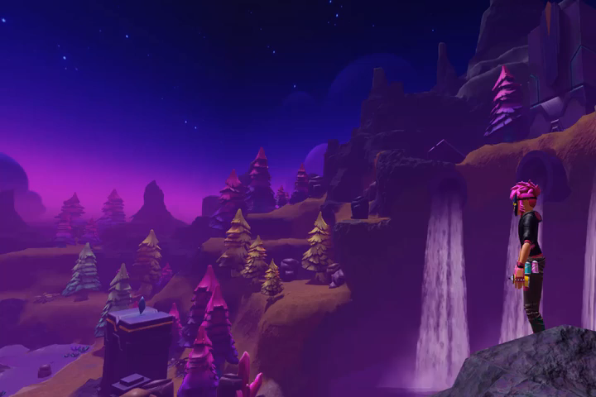
Intro Video

Slide 3
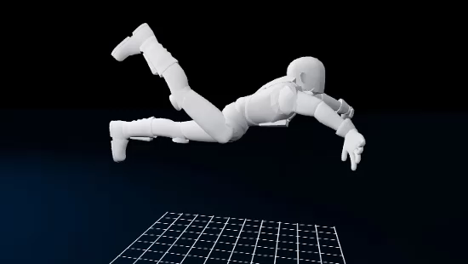
What is an Animation?
Animation: A series of images used to create the illusion of movement.
Our animation will use poses to stimulate the body moving.
Notice how 2 poses combine to create a swimming animation
  First and last are the same pose

Slide 4
Brainstorm Animation Ideas
YOUR CHALLENGE
Envision an animation idea, then collect inspiration

Slide 5


Brainstorm and Draw an Animation
Envision an animation idea. Think of sports, actions, or things animals do.
Physically act out the animation you want to create.
Then, draw at least 2 simple sketches using stick figures.
Focus on how body parts move in your drawing, not drawing skills.

Slide 6
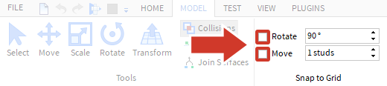
Animation Creation Tips
Make sure to turn off Snap to Grid
Use the Camera Controls
Action | Control
Move | W A S D
Rotate | Hold the right mouse button and look around
Zoom | Use the scroll wheel
Focus | Press F to focus the camera on a specific part

Slide 7
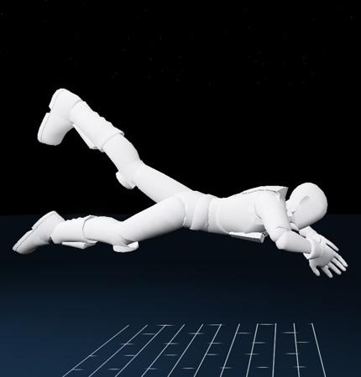
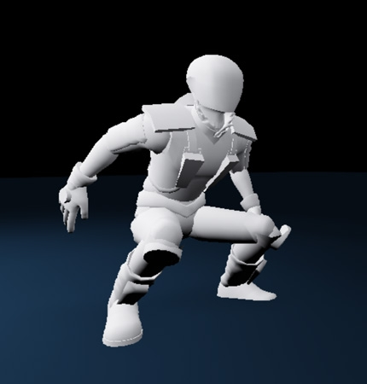
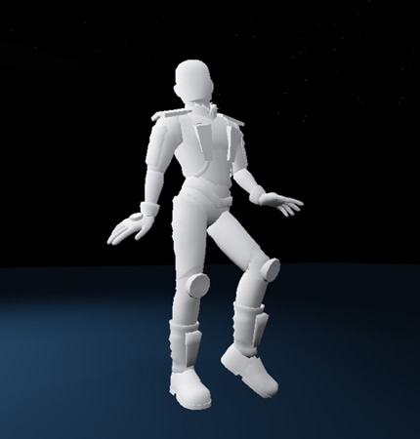
Example First Poses
Swimming
Jumping
Dancing

Slide 8
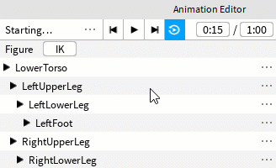
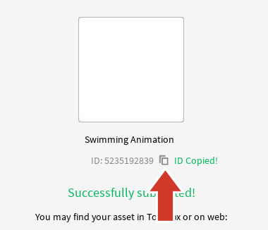
Export and Play Animations
In the Animation Editor, click […] and select Export.
Be sure to copy the animation ID.

Slide 9
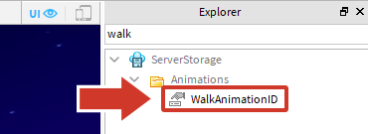
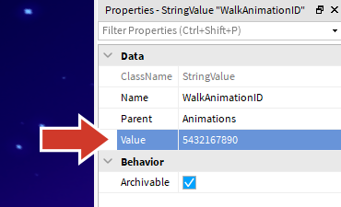
Export and Play Animations
In the Explorer, search for “walk” and click WalkAnimationID.
In the Properties, paste the ID in Value.

Slide 10
Tips for Better Animations
Add more poses
  More poses make animations look smoother.
Exaggerate a pose.
  Make an arm swim even more wild. Bend a head up or downwards.
Give your pose personality.
  Is your walking animation for someone who’s slow or trying to get somewhere fast?

